Slide 1

Future of Environment Protection Energy, Water, Environment Sustainability
Department of Engineering & Applied Science
Roll No. | PRN | Name of student | Div. | VIIT email ID
1405 | 22110075 | Yash Gavit | N | yash.22110075@viit.ac.in
1412 | 22110206 | Prasad Nathe | N | prasad.22110206@viit.ac.in
1418 | 22110305 | Sahil Savardekar | N | sahil.22110350@viit.ac.in
1421 | 22110398 | Siddhesh Khairnar | N | siddhesh.22110398@viit.ac.in
BRACT’S, Vishwakarma Institute of Information Technology, Pune-48
(An Autonomous Institute affiliated to Savitribai Phule Pune University)
(NBA and NAAC accredited, ISO 9001:2015 certified)

Slide 2
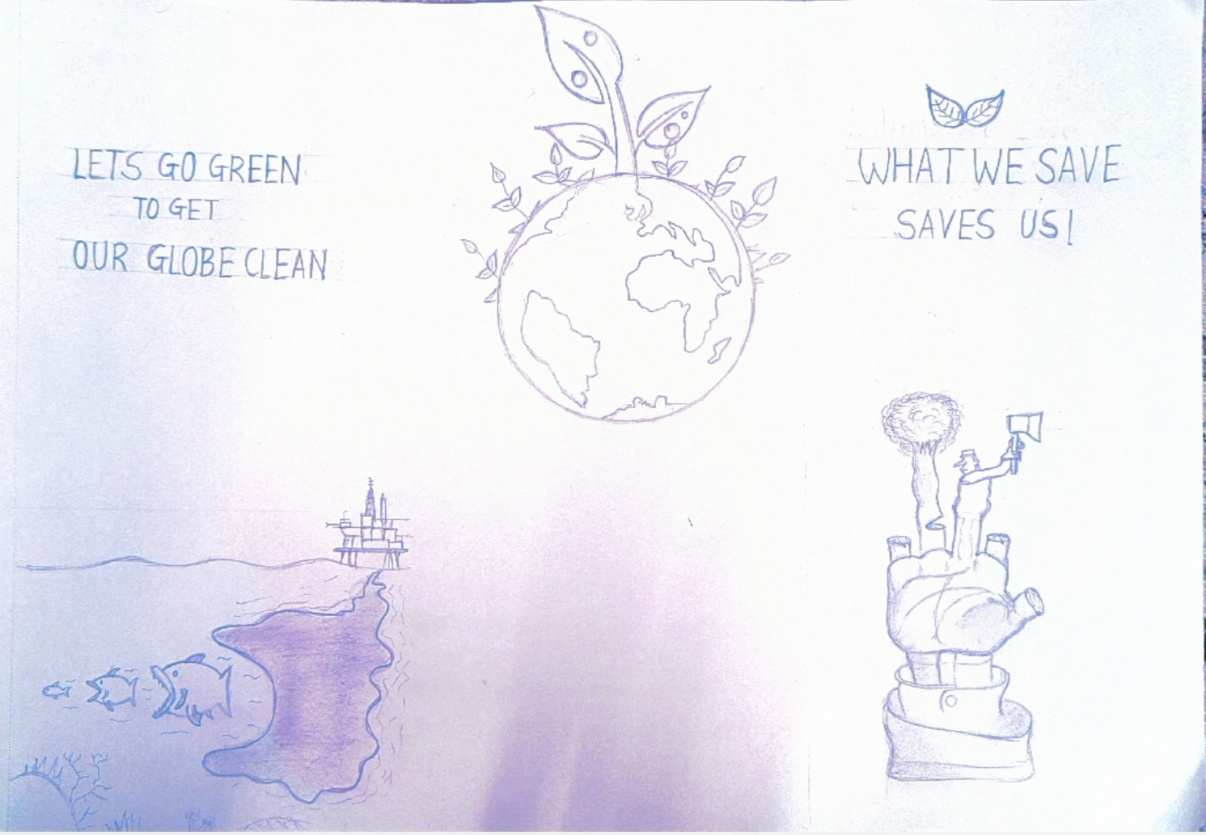
Sahil Savardekar , Department of Engineering and Applied Sciences, VIIT, Pune-48

Slide 3
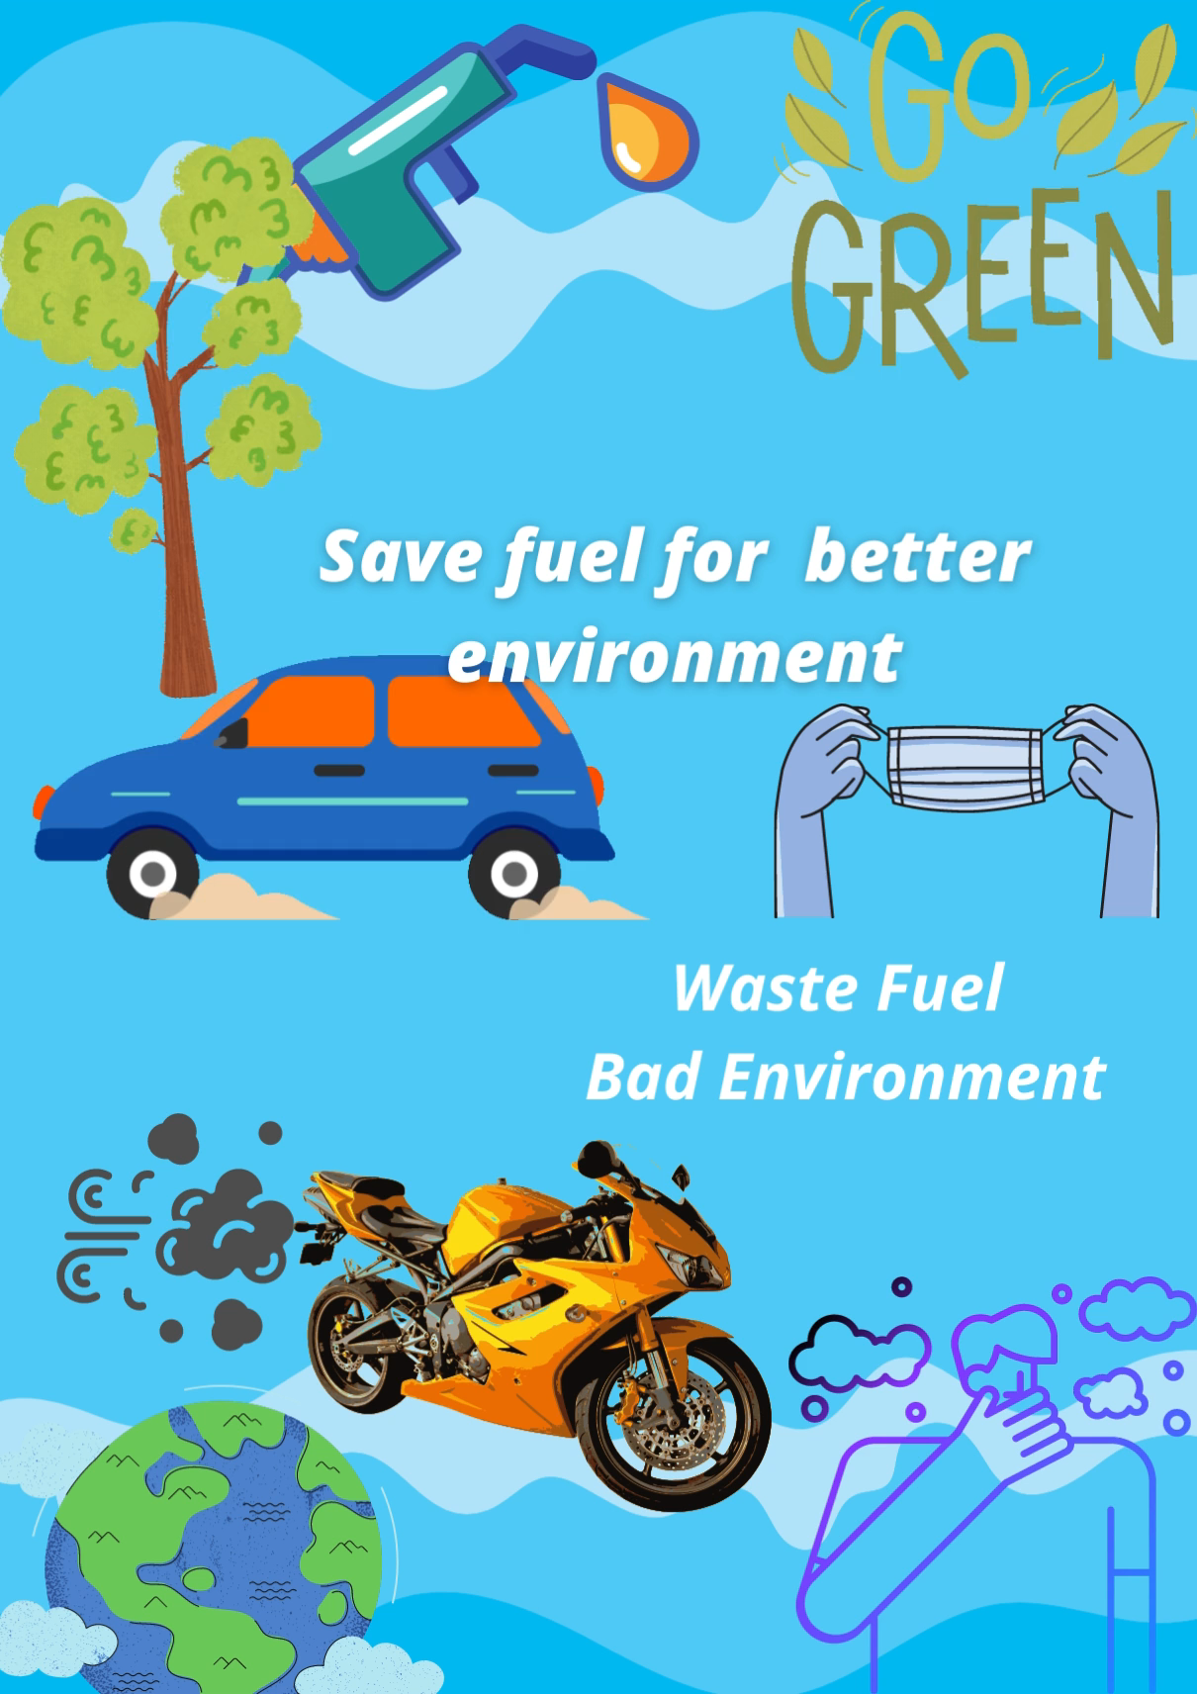
Prasad Nathe, Department of Engineering and Applied Sciences, VIIT, Pune-48

Slide 4

Siddhesh Khairnar, Department of Engineering and Applied Sciences, VIIT, Pune-48

Slide 5
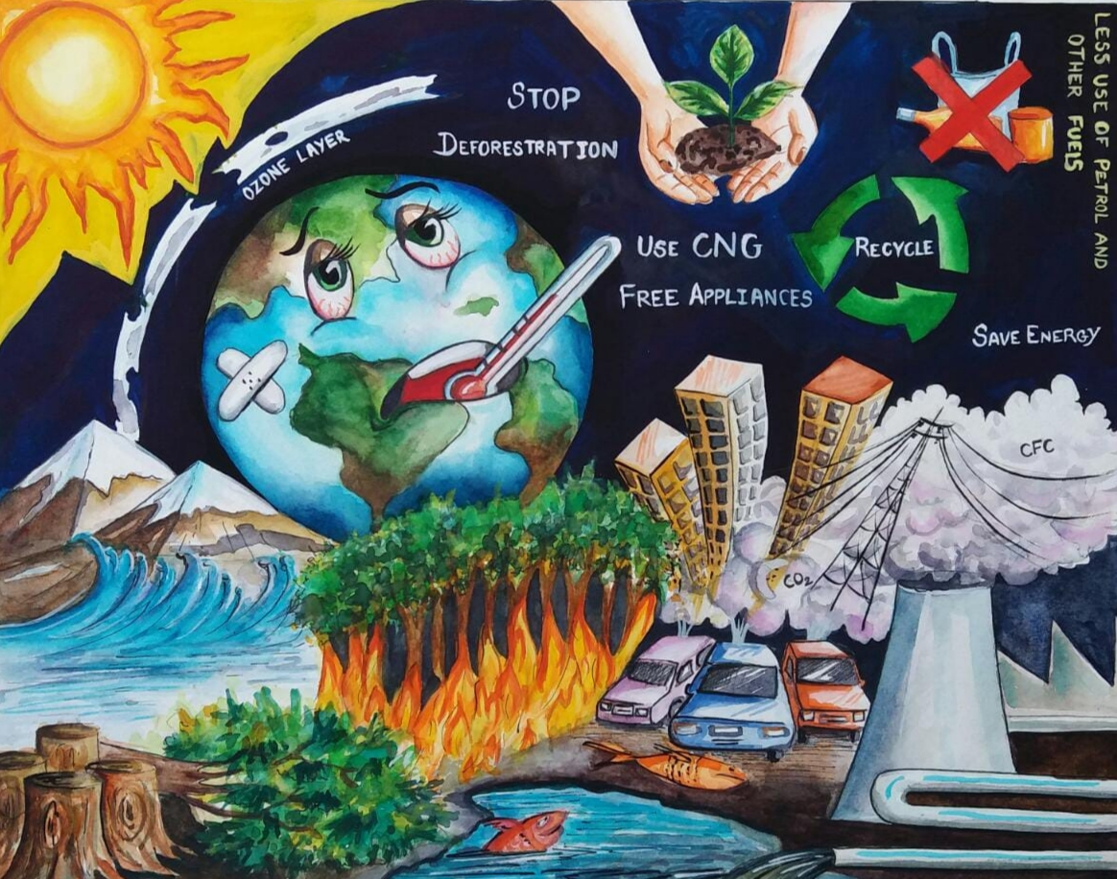
Yash Gavit, Department of Engineering and Applied Sciences, VIIT, Pune-48

Slide 6
Thank You
Mr. Vivek Shripad Nagnath, Department of Engineering and Applied Sciences, VIIT, Pune-48

